Slide 1
Trustworthy Machine Learning Adversarial Examples and Heuristic Adversarial Learning
Sangdon Park
POSTECH

Slide 2
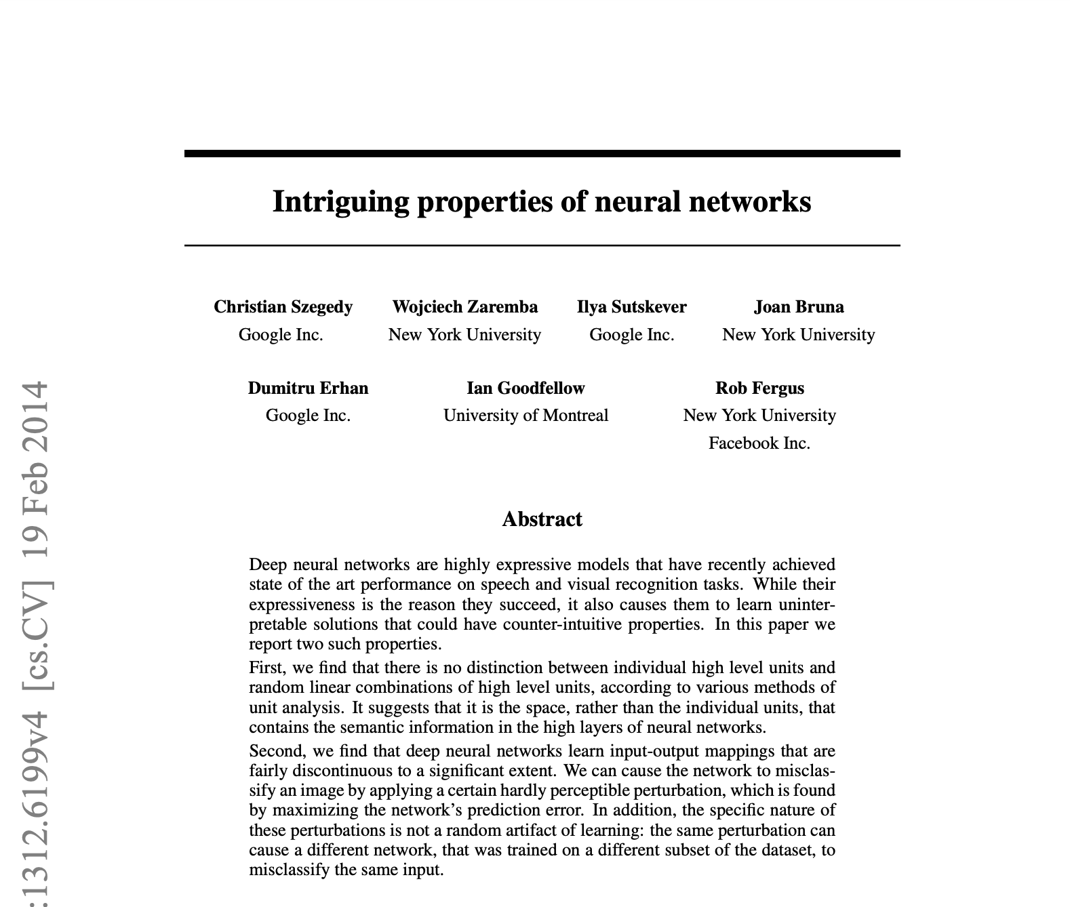
Intriguing Properties of Neural Networks
One of 35 papers, presented at the 2nd International Conference on Learning Representations (ICLR),
held in 2014

Slide 3
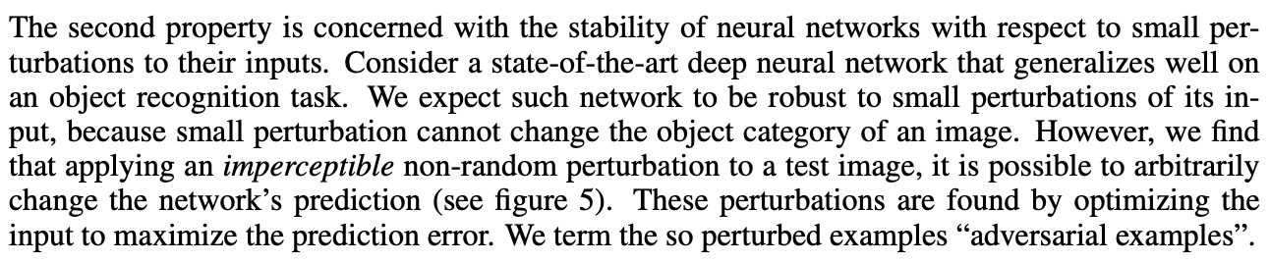
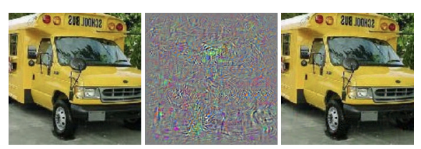
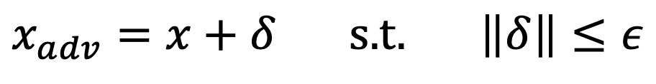
Adversarial Examples
$$x_{adv}=x+δ \text{s}\text{.}\text{t}\text{.} \left\|δ\right\|≤ε$$
Adversarial perturbation

Slide 4
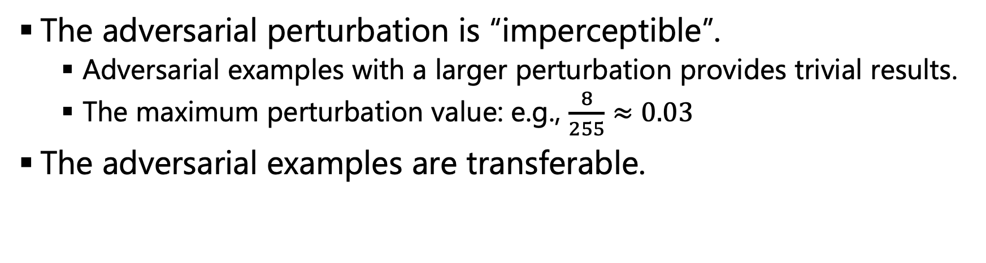
Why “Intriguing”?
The adversarial perturbation is “imperceptible”.
Adversarial examples with a larger perturbation provides trivial results.
The maximum perturbation value: e.g., $\frac{8}{255}≈0.03$
The adversarial examples are transferable.

Slide 5
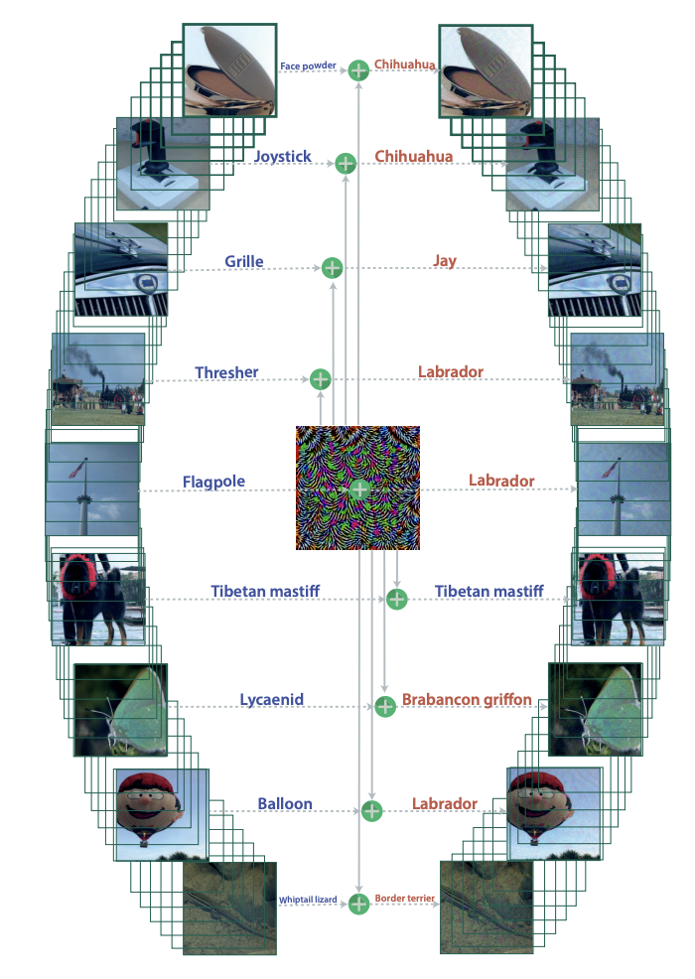
Why “Intriguing”?
There exists one adversarial perturbation that makes the most images being misclassified
Universal adversarial perturbations (CVPR17)

Slide 6
Contents
How to generate adversarial examples?
How to (heuristically) learn a robust network to adversarial examples?
What is the cause of adversarial examples?
Is it practical?

Slide 7
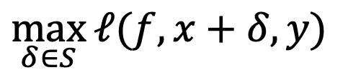
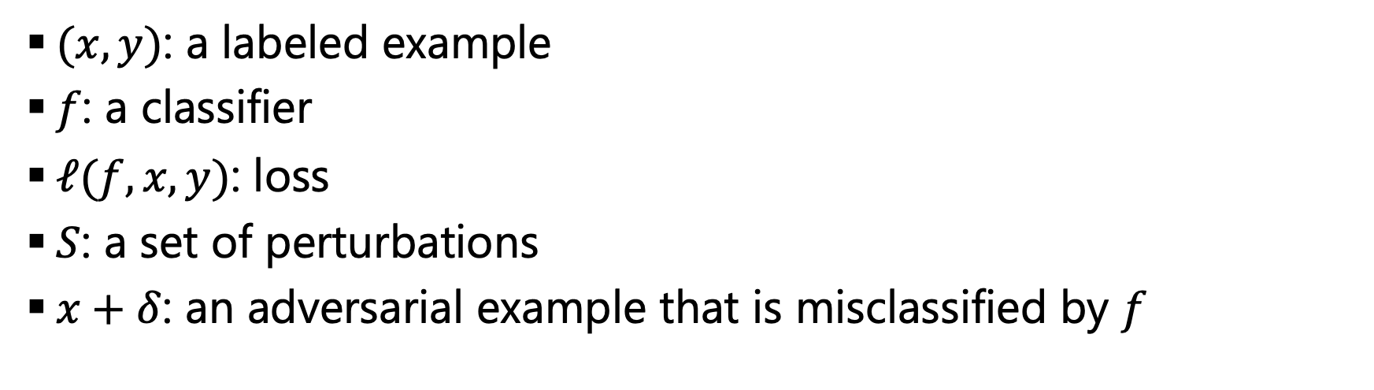
Generating Adversarial Examples High-level Objective
$$\max_{δ∈S}{ℓ(f, x+δ, y)}$$
$(x, y)$: a labeled example
$f$: a classifier
$ℓ(f, x, y)$: loss
$S$: a set of perturbations
$x+δ$: an adversarial example that is misclassified by $f$

Slide 8
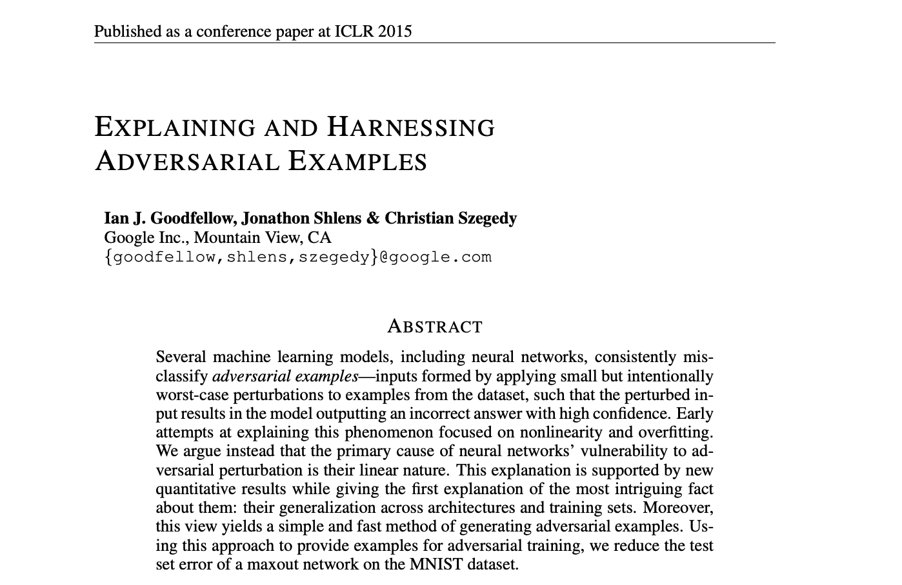
FGSM: Fast Gradient Sign Method THE LINEAR EXPLANATION OF ADVERSARIAL EXAMPLES

Slide 9
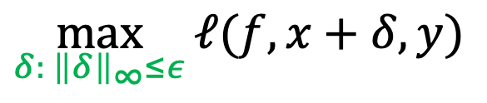
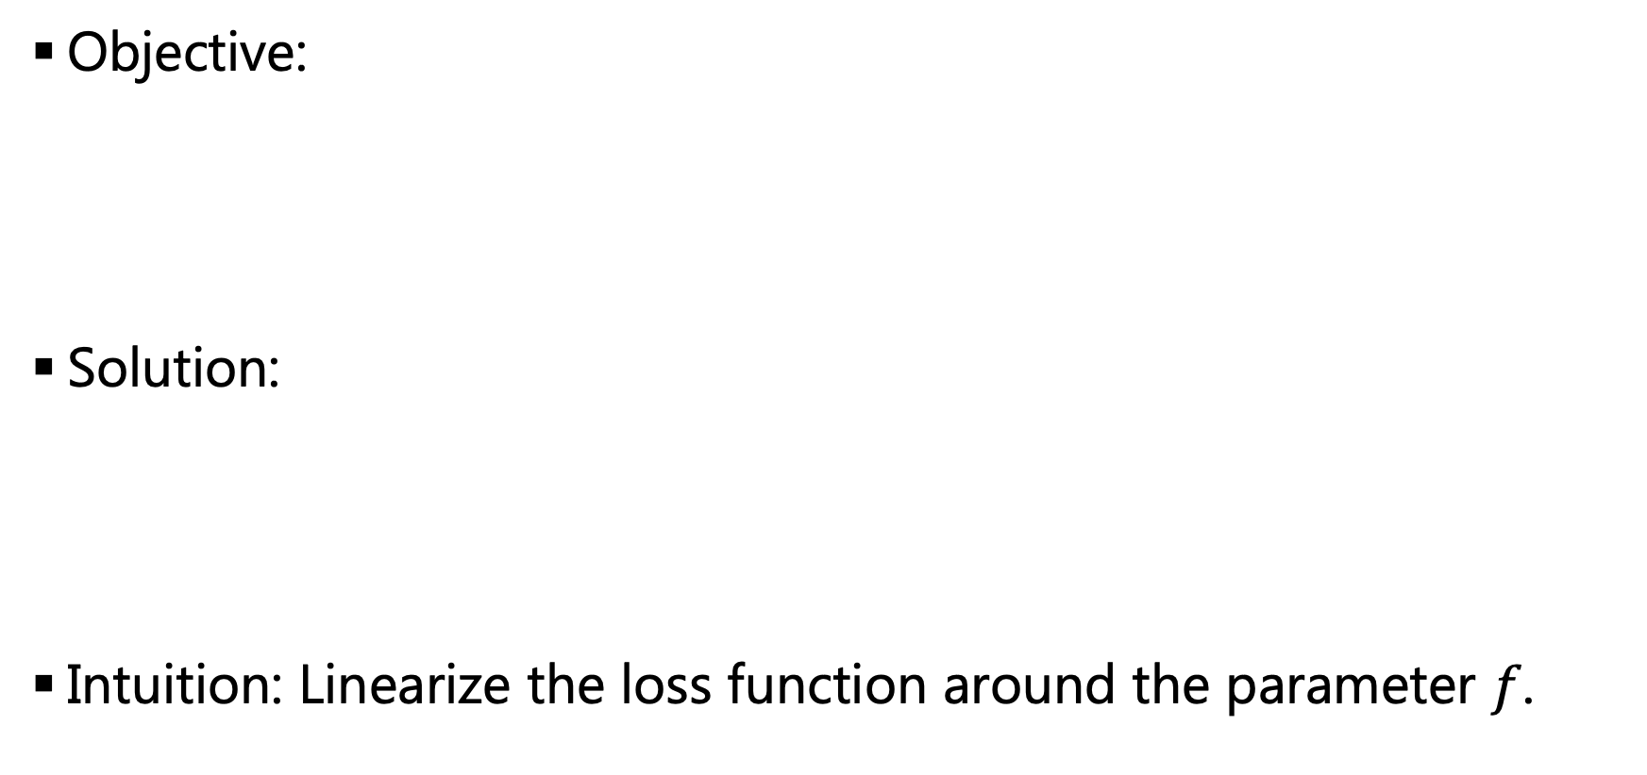
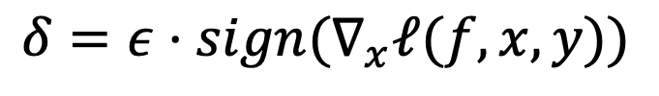
FGSM
Objective:
Solution:
Intuition: Linearize the loss function around the parameter $f$.
$$\max_{δ: {\left\|δ\right\|}_{∞}≤ε}{ℓ(f, x+δ, y)}$$
$$δ=ε⋅sign(∇_{x}ℓ(f, x, y))$$

Slide 10
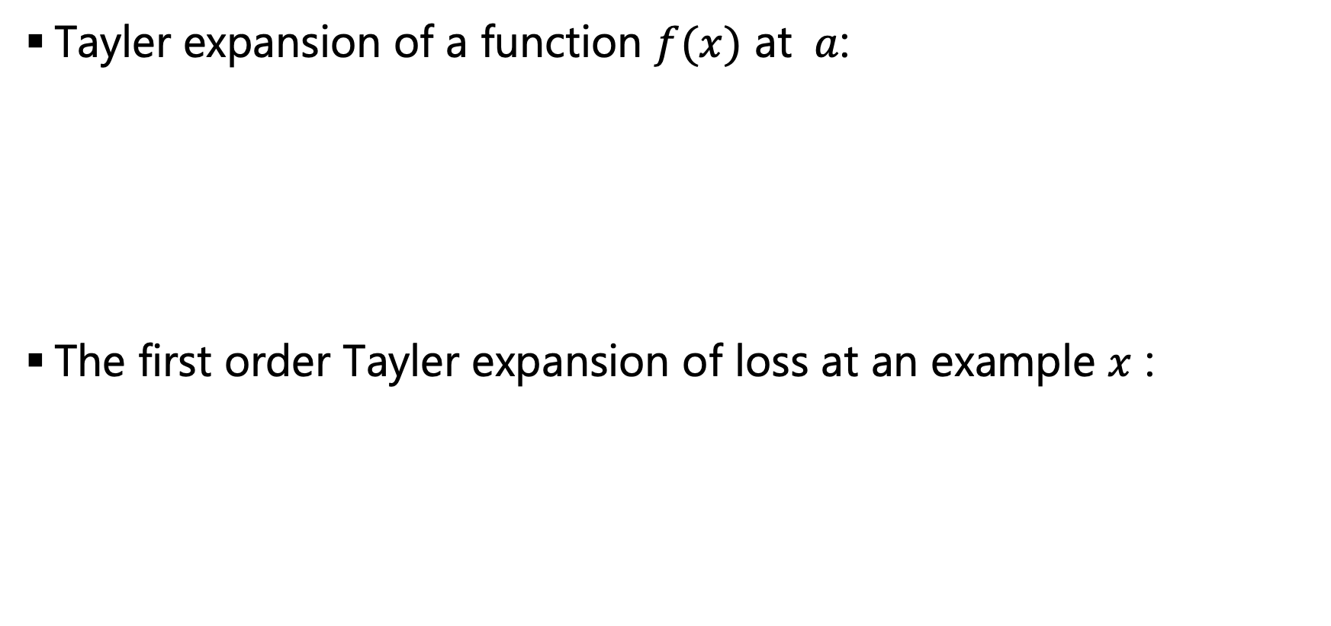
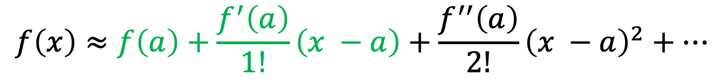
FGSM: Optimality Analysis
Tayler expansion of a function $f(x)$ at $a$:
The first order Tayler expansion of loss at an example $x$ :
$$f\left(x\right)≈f\left(a\right)+\frac{f^{′}\left(a\right)}{1!}\left(x −a\right)+\frac{f^{′′}\left(a\right)}{2!}{\left(x −a\right)}^{2}+…$$
$$ℓ\left(f, x+δ, y\right)=:ℓ′(x+δ)≈ℓ′\left(x\right)+∇ℓ′{\left(x\right)}^{T}δ$$
A Unified Gradient Regularization Family for Adversarial Examples. ICDM2015.

Slide 11
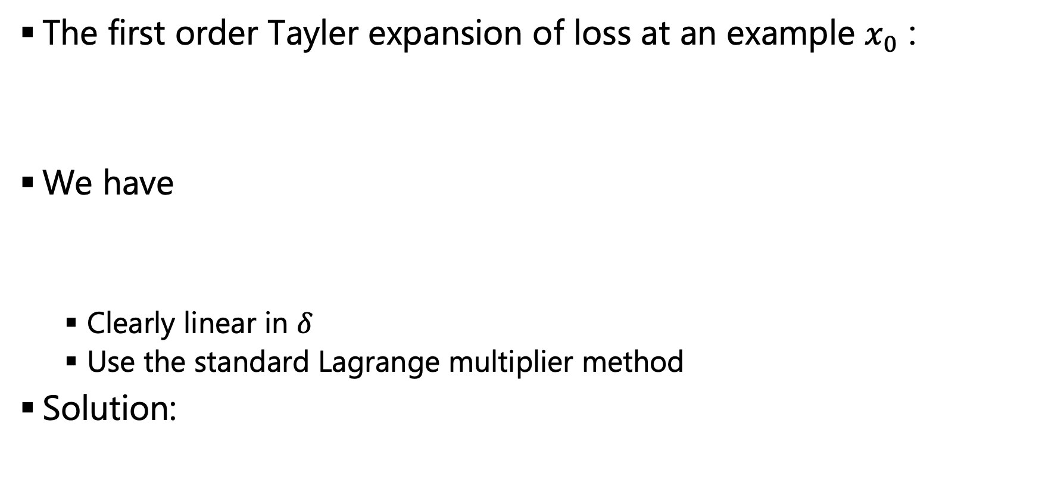
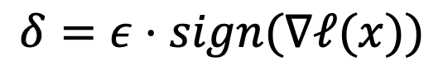
FGSM: Optimality Analysis
The first order Tayler expansion of loss at an example $x_{0}$ :
We have
Clearly linear in $δ$
Use the standard Lagrange multiplier method
Solution:
$$ℓ\left(f, x+δ, y\right)=:ℓ′(x+δ)≈ℓ′\left(x\right)+∇ℓ′{\left(x\right)}^{T}δ$$
$$\max_{δ: {\left\|δ\right\|}_{∞}≤ε}{ℓ(f, x+δ, y)}≈\max_{δ: {\left\|δ\right\|}_{∞}≤ε}{ℓ\left(x\right)+∇ℓ{\left(x\right)}^{T}δ}$$
$$δ=ε⋅sign(∇ℓ(x))$$

Slide 12
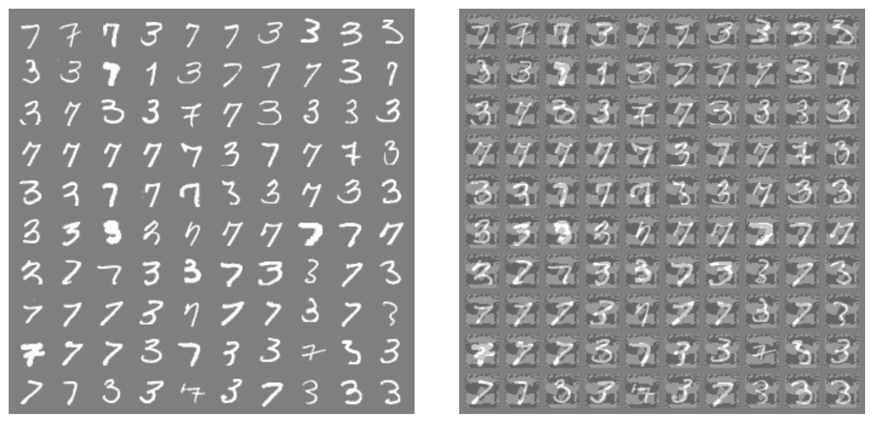
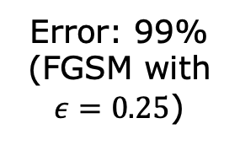
FGSM Results
Error: 1.6%
Error: 99%
(FGSM with
$ε=0.25$)
Results with a linear model
FGSM generates (almost) optimal perturbations.

Slide 13
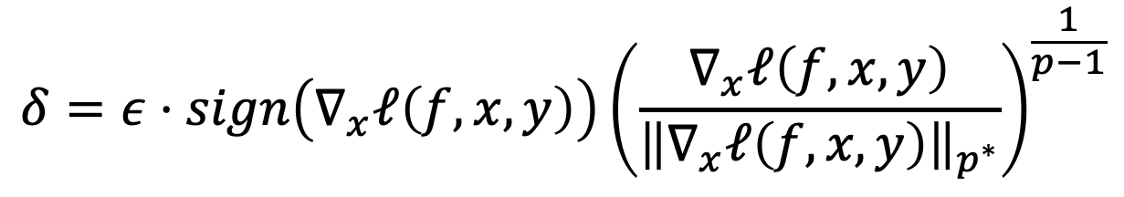
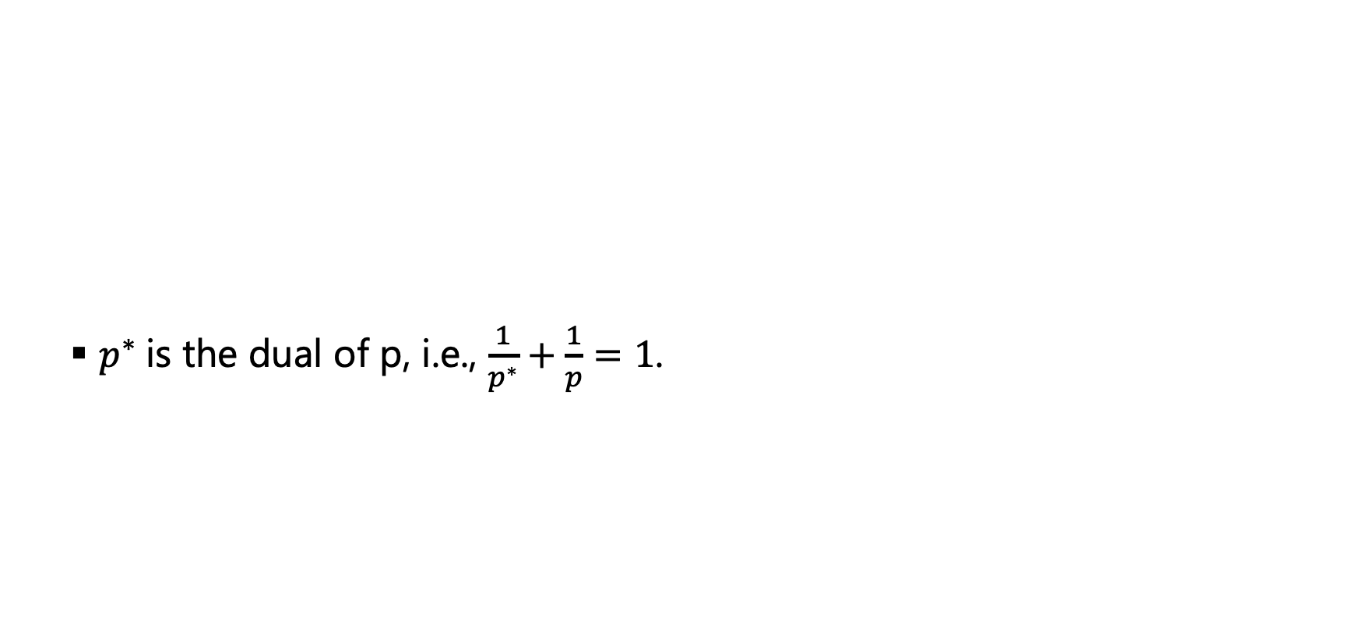
General Framework Gradient regularization family (1/2)
$p^{∗}$is the dual of p, i.e., $\frac{1}{p^{∗}}+\frac{1}{p}=1$.
$$δ=ε⋅sign\left(∇_{x}ℓ\left(f, x, y\right)\right){\left(\frac{∇_{x}ℓ\left(f, x, y\right)}{{\left\|∇_{x}ℓ\left(f, x, y\right)\right\|}_{p^{∗}}}\right)}^{\frac{1}{p−1}}$$
A Unified Gradient Regularization Family for Adversarial Examples. ICDM2015.

Slide 14
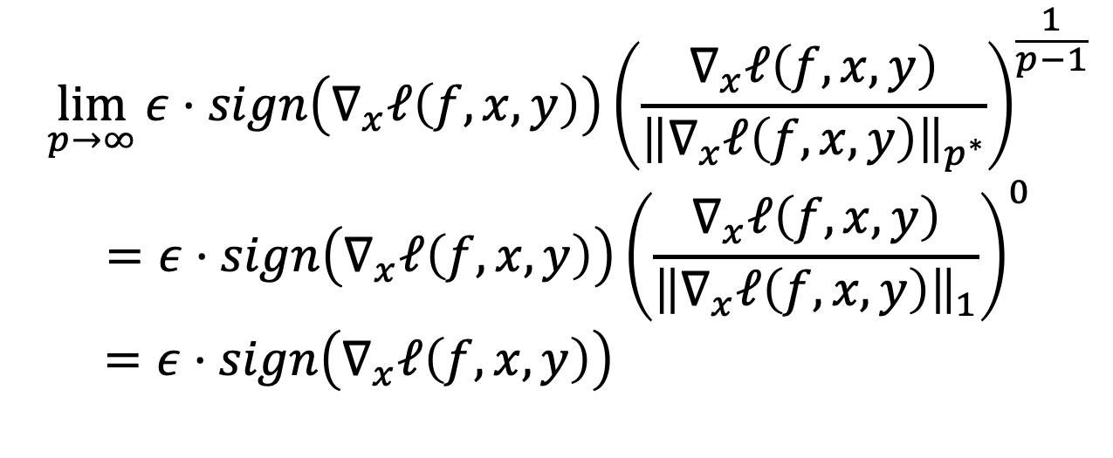
General Framework Gradient regularization family (2/2)
$$\lim_{p→∞}{ε⋅sign\left(∇_{x}ℓ\left(f, x, y\right)\right){\left(\frac{∇_{x}ℓ\left(f, x, y\right)}{{\left\|∇_{x}ℓ\left(f, x, y\right)\right\|}_{p^{∗}}}\right)}^{\frac{1}{p−1}}}$$
$$=ε⋅sign\left(∇_{x}ℓ\left(f, x, y\right)\right){\left(\frac{∇_{x}ℓ\left(f, x, y\right)}{{\left\|∇_{x}ℓ\left(f, x, y\right)\right\|}_{1}}\right)}^{0}$$
$$=ε⋅sign\left(∇_{x}ℓ\left(f, x, y\right)\right)$$
We have FGSM!
A Unified Gradient Regularization Family for Adversarial Examples. ICDM2015.

Slide 15
“Iterative” FGSM
FGSM finds an adversarial example under the “linear” assumption
The loss landscape is more complex
“Iterative” FGSM (by Google)
ADVERSARIAL MACHINE LEARNING AT SCALE (ICLR2017)
Project Gradient Descent (PGD)
Towards Deep Learning Models Resistant to Adversarial Attacks (ICLR2018)

Slide 16
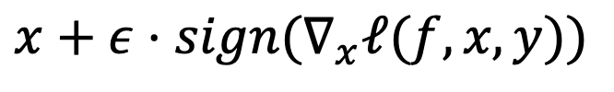
PGD
One-step attack
Multi-step attack
$$x+ε⋅sign(∇_{x}ℓ(f, x, y))$$
$$x^{t+1}=Π_{x+S}(x^{t}+α⋅sign(∇_{x^{t}}ℓ\left(f, x^{t}, y\right)))$$
Towards Deep Learning Models Resistant to Adversarial Attacks (ICLR2018)

Slide 17
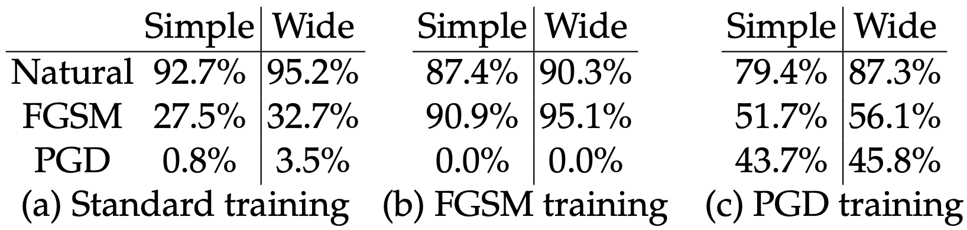
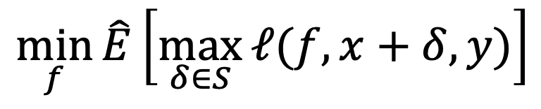

Adversarial Training
Objective:
$$\min_{f}{\hat{E}\left[\max_{δ∈S}{ℓ(f, x+δ, y)}\right]}$$
Approximate via an attack algorithm (e.g., PGD)
CIFAR10 ($ε=8/255$)

Slide 18
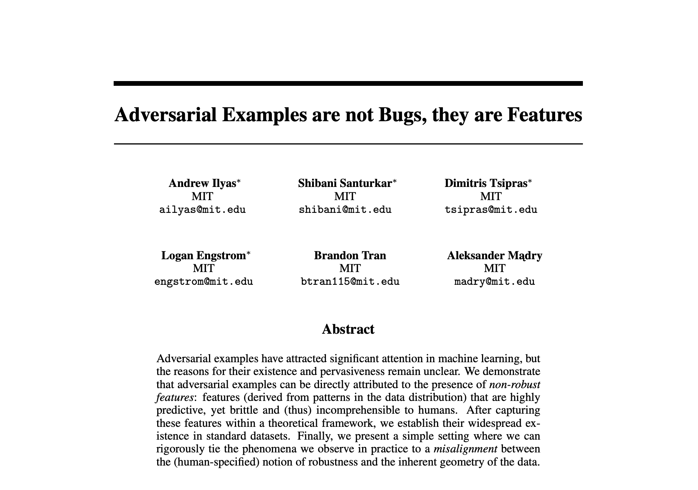
What’s the Cause of Adversarial Examples?
NeurIPS 2019

Slide 19
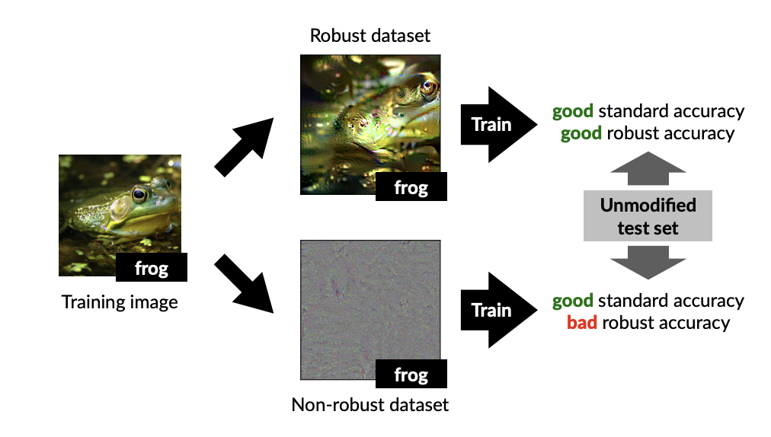
Experiment Setup
Claim: There are two features: (1) robust features and (2) non-robust features; the non-robust features contribute to adversarial examples!

Slide 20
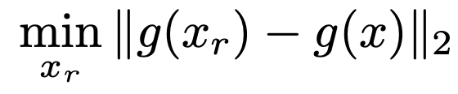
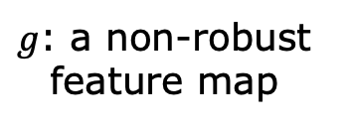
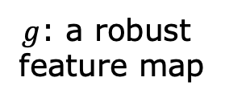
How to Construct Datasets
Initialized with
a randomly chosen image
$g$: a robust
feature map
$g$: a non-robust
feature map

Slide 21
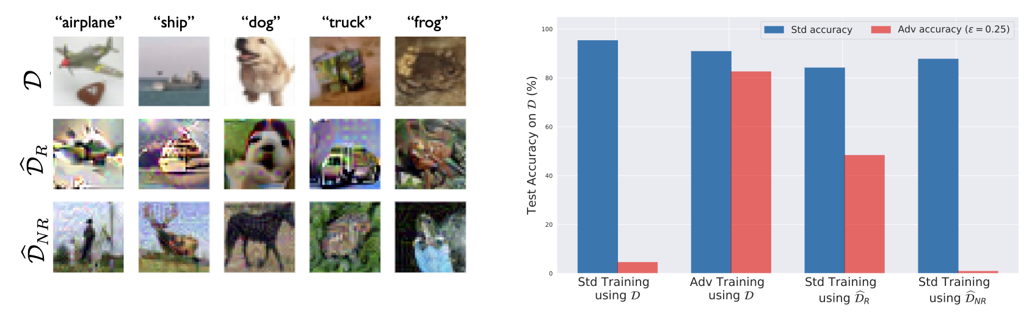
Results
The standard model picks (noisy-looking) non-robust features to classify images; thus, it is susceptible to adversarial perturbations.

Slide 22
Wait! Practical?
How can an attacker inject an adversarial example in practice?

Slide 23
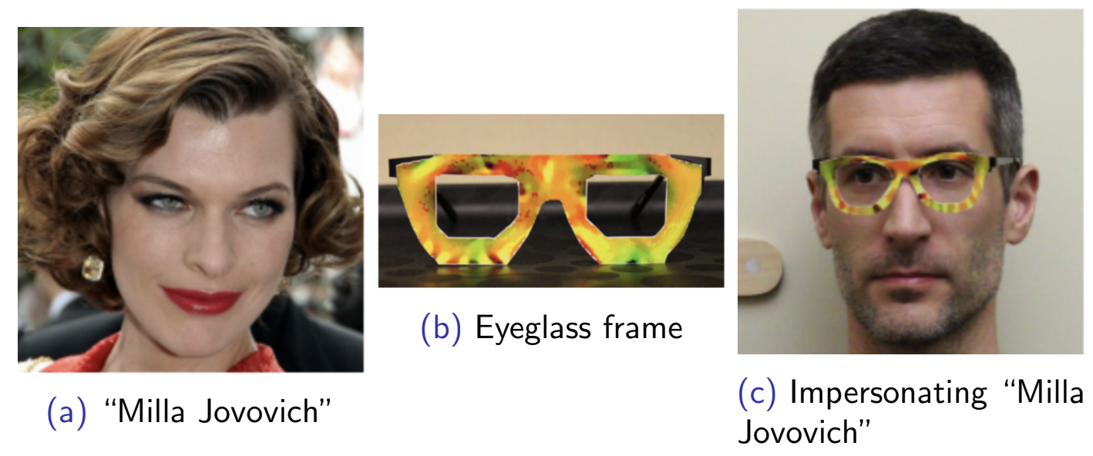
Adversarial Glasses
Accessorize to a Crime: Real and Stealthy Attacks on State-of-the-Art Face Recognition (CCS16)

Slide 24
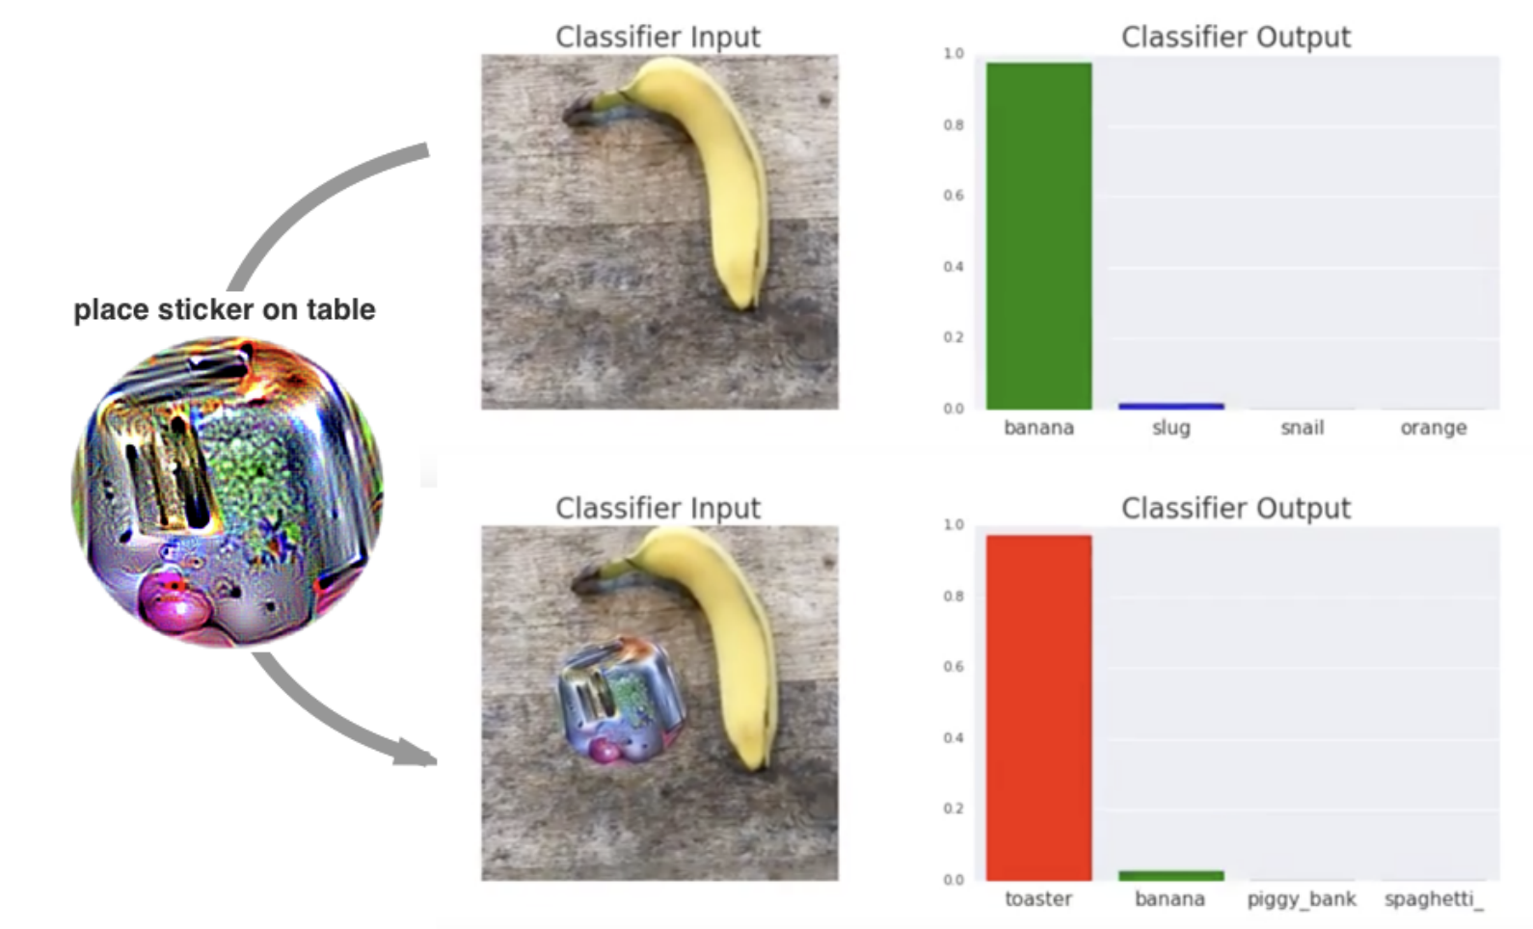
Adversarial Patch
Adversarial Patch (NIPS17 Workshop)

Slide 25
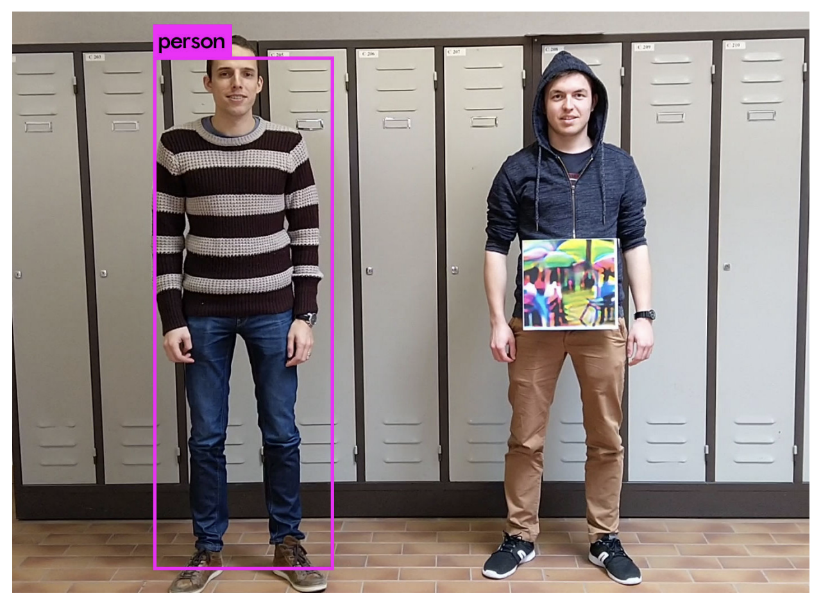
Adversarial Patch for Object Detectors
Fooling Automated Surveillance Cameras: Adversarial Patches to Attack Person Detection (CVPR19 Workshop)

Slide 26
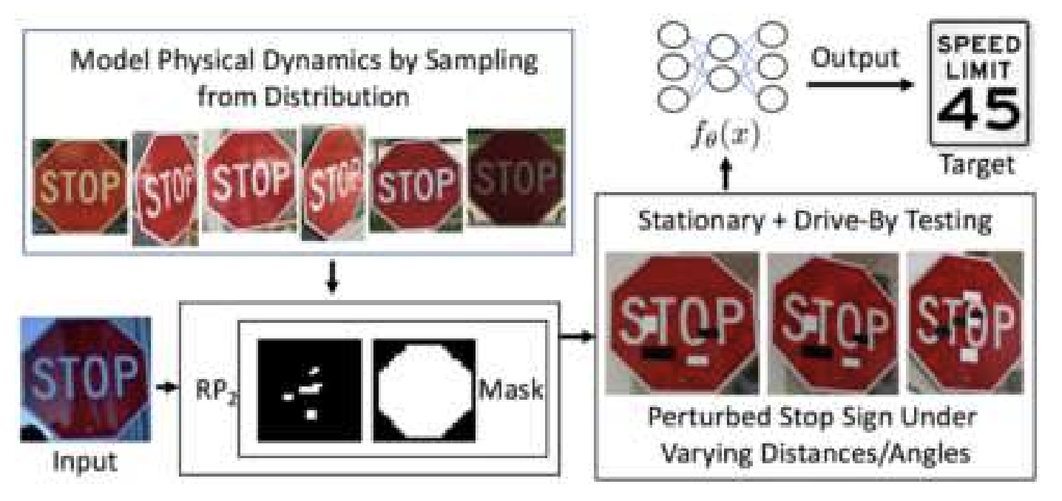
Physical Adversarial Examples
Robust Physical-World Attacks on Deep Learning Visual Classification (CVPR18)

Slide 27
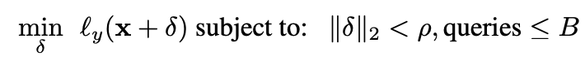
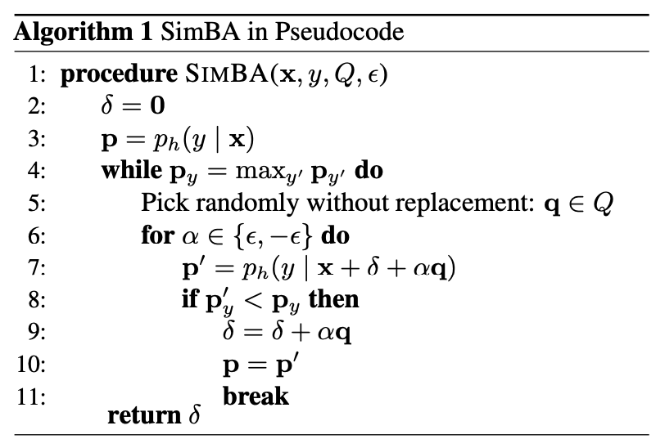
Black-Box Attacks
What if we don’t have a target model?
Observation: random noise in low frequency space is more likely to be adversarial
Simple Black-box Adversarial Attacks (ICML19)

Slide 28
Conclusion
Small adversarial perturbations degrade the perforance of predictors.
Adversarial perturbations are realizable.
Phyiscal adversarial examples
Eyeglass
Adversarial patch
Even without complete knowledge on a model, we can generate adversarial perturbations.
How can we learn a neural network that is robust to adversarial perturbations with guarantees?

